Slide 1
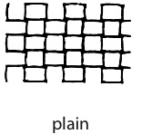
Plain Weave
The simplest and most common weave pattern
The warp and weft yarns pass under each other alternately (1 over, 1 under)
Design resembles a checkerboard

Slide 2
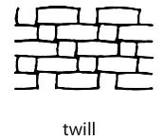
Twill Weave
The warp yarn is passed over two to three weft yarns before going under one
(2 or 3 over, 1 under)
Makes a diagonal/stairs weave pattern
Denim is one of the most common examples

Slide 3
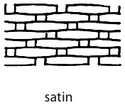
Satin Weave
The yarn interlacing is not uniform
Creates long floats
Interlacing weave passes over four or more yarns (4 or more over, 1 under)
Satin is the most obvious example

